Slide 1
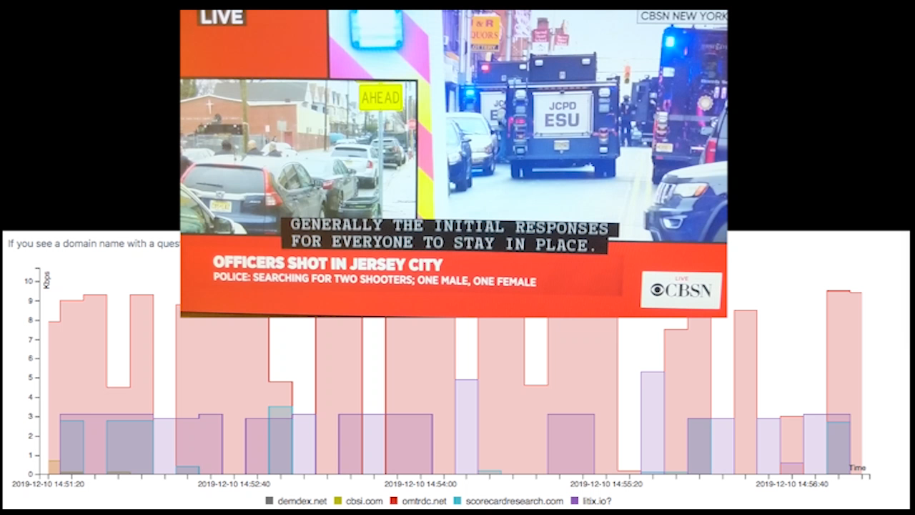

CBS watches me watching CBS

Slide 2






Consumers face a large variety of security and privacy threats
malware attacks
privacy leaks
Who are the adversaries?
How do they cause harm?
How to protect consumers?

Slide 3


Challenges for empirically studying security & privacy threats
Challenges
I build measurement systems to study in the wild and in the lab
in the wild
discover systematic trend
measuring at scale
placing observation points
protecting privacy of subjects
discover systematic trend
in the lab
achieving realistic interactions
understanding underlying behaviors
identify initial evidence
deep-dive

Slide 4




Smart home IoT security & privacy
arXiv ‘19, CCS ‘19
in the wild
discover systematic trend
measuring at scale
placing observation points
protecting privacy of subjects
Built system that crowd-sources network traffic
in the lab
achieving realistic interactions
understanding underlying behaviors
Built system that interacts with smart TV apps
deep-dive
5k users 50k devices
tracking on smart TVs
child privacy violation
FTC investigations

Slide 5







Studying cyber-criminal ecosystem
IEEE S&P ’18, KDD ‘17, NDSS ‘14
network infrastructure
cryptocurrency payments
in the wild
discover systematic trend
measuring at scale
placing observation points
protecting privacy of subjects
Built system that interacts with criminals to study internal activities
in the lab
Built system that interacts with malware to establish ground truth
achieving realistic interactions
understanding underlying behaviors
Identify initial evidence
discovered ecosystem & weaknesses
$16 million illicit bitcoins
industry intervention
FBI investigations

Slide 6
Focus of the talk: Smart home IoT security & privacy
in the wild
discover systematic trend
Built system that crowd-sources network traffic [arXiv ‘19]
1
in the lab
Built system that interacts with smart TV apps [CCS ‘19]
2
deep-dive

Slide 7
Discovering smart home IoT security & privacy threats in the wild
1
Danny Yuxing Huang, Noah Apthorpe, Gunes Acar, Frank Li, Nick Feamster
arXiv ’19 (in submission)

Slide 8






Many smart home IoT devices, but few systematic insights
Heterogeneity in device types, design, and implementation
Diverse user behaviors in the wild

Slide 9


Challenges of identifying IoT security & privacy threats at scale
IoT security and privacy research
web & mobile
lab studies
Internet scanning
Crowdsourcing
scale
active probing
passive traffic

Slide 10
Crowdsourcing IoT network traffic at scale
Vision
Simple tool that can anyone can use to identify the otherwise hidden activities of IoT devices
Design Goals
For recruiting users
Easy to use
Generates insights
Protects privacy
For researchers
Large, labeled dataset

Slide 11


IoT Inspector: a system to crowdsource IoT traffic at scale
IoT Inspector (iot-inspector.princeton.edu)
Design Goals
For recruiting users
Easy to use
Generates insights
Protects privacy
For researchers
Large, labeled dataset

Slide 12

How to make IoT Inspector easy to use?
Design Goals
For recruiting users
Easy to use
Generates insights
Protects privacy
For researchers
Large, labeled dataset

Slide 13
IoT Inspector uses ARP spoofing to capture traffic
To router:
I’m the camera
To camera:
I’m the router

Slide 14
IoT Inspector uses ARP spoofing to capture traffic
To router:
I’m the lightbulb
To lightbulb:
I’m the router

Slide 15
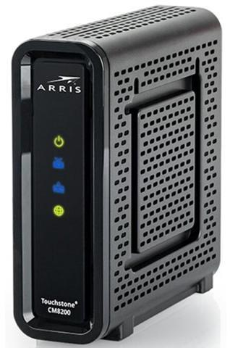
IoT Inspector uses ARP spoofing to capture traffic
Challenge
Some IoT devices or routers do not accept spoofed ARP packets.

Slide 16
IoT Inspector uses TCP Ack Numbers to infer traffic rate
IoT Inspector observes outbound TCP traffic
Seq 1:100, Ack 1
Seq 100:200, Ack 1
Seq 200:300, Ack 51
Seq 300:400, Ack 72
inbound
Inbound
50 bytes
outbound
Inbound
20 bytes

Slide 17
IoT Inspector: a system to crowdsource IoT traffic at scale
IoT Inspector (iot-inspector.princeton.edu)
Usage statistics
Publicly release in May ‘19
5k+ users worldwide
50k+ devices
Passive traffic
Device labels
Examples: Smart TVs, plugs, lightbulbs, camera, Tesla

Slide 18
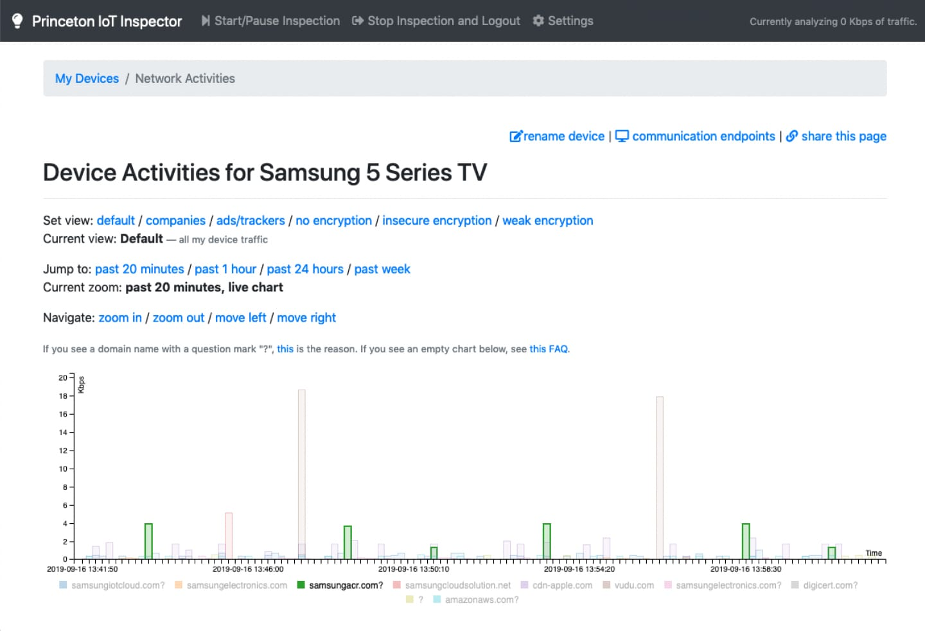
Design goal: to generates insights
Design Goals
For recruiting users
Easy to use
Generates insights
Protects privacy
For researchers
Large, labeled dataset

Slide 19


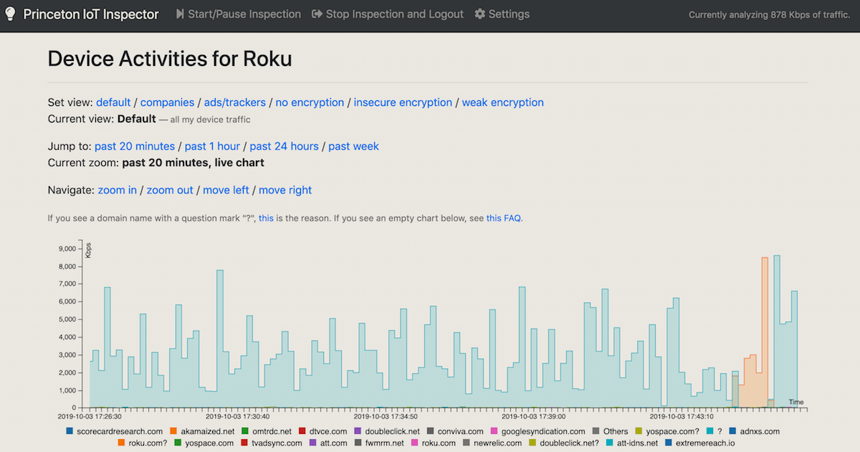

Screenshot of IoT Inspector from a user
Ira Flatow
Host of Science Friday
“Here is what the Princeton IoT Inspector tracked in a 20 minute time span on Ira’s Roku.”
(October 4, 2019)

Slide 20

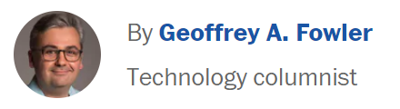
Screenshot of IoT Inspector from a user
“Then using software from Princeton University called the IoT Inspector, I watched how each [TV] model transmitted data.”
(September 18, 2019)

Slide 21
Features of IoT Inspector
Design Goals
For recruiting users
Easy to use
Generates insights
Protects privacy
For researchers
Large, labeled dataset
Trade-off between ease of use and abuse
Detects non-IoT devices based on heuristics
User encouraged to label devices
50k devices, 20% of devices labeled

Slide 22
Findings: Ineffective encryption on IoT devices
number of devices | TLS 1.2 | TLS 1.1 | TLS 1.0 | SSL 3.0 Deprecated in 2015 | RC4 in ClientHello Attack found in 2002
669 | 645 |  | 31 |  | 9
614 | 613 | 1 | 67 | 5 | 397
148 | 129 |  | 41 |  | 80

Slide 23




Finding: Smart TVs communicate with 3rd-party ad/tracking services
blacklist
doubleclick.net
googlesyndication.com
scorecardresearch.com
fwmrm.net
69.7% of smart TVs
14.9% of smart TVs
4.3% of smart TVs
Which smart TV apps?
What sensitive data is shared?
Shared with whom?

Slide 24











Opportunities for further research
device identification
anomaly detection
3rd-party identification
healthcare

Slide 25



Summary of IoT Inspector
Built a system to gather empirical evidence of security and privacy threats from 50k+ devices and 5k users
Which smart TV apps track users?
What sensitive data is shared? With whom?
Empowers consumers with simple tool
Helps journalist raise awareness
Facilitates investigations to push for policy changes
Provides researchers with new insights

Slide 26
Summary of the talk: Smart home IoT security & privacy
in the wild
discover systematic trend
Built system that crowd-sources network traffic [arXiv ‘19]
1
in the lab
Built system that interacts with smart TV apps [CCS ‘19]
2
deep-dive

Slide 27
Analyzing tracking on smart TVs
2
Hooman Mohajeri Moghaddam, Gunes Acar, Arunesh Mathur, Ben Burgess, Danny Yuxing Huang, Prateek Mittal, Nick Feamster, Arvind Narayanan, Edward Felten
ACM Conference on Computer and Communications Security (CCS). 2019.

Slide 28
Recap: Using IoT Inspector to watch CBS
What sensitive data is shared?
From which smart TV apps?
Shared with whom?

Slide 29
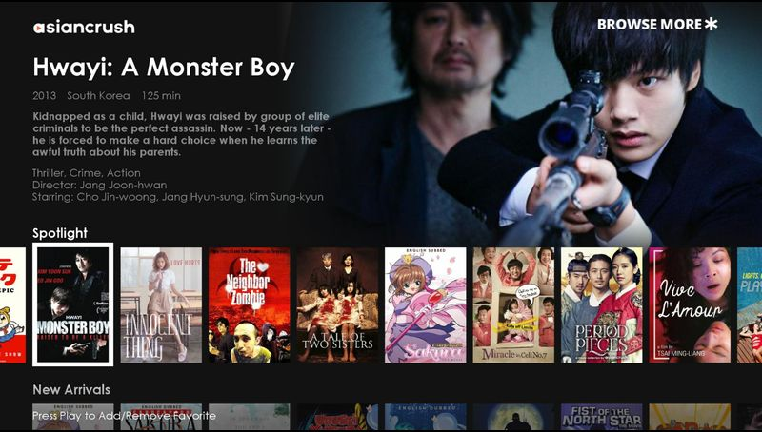
Challenges of analyzing smart TV traffic in lab
tcpdump

Slide 30

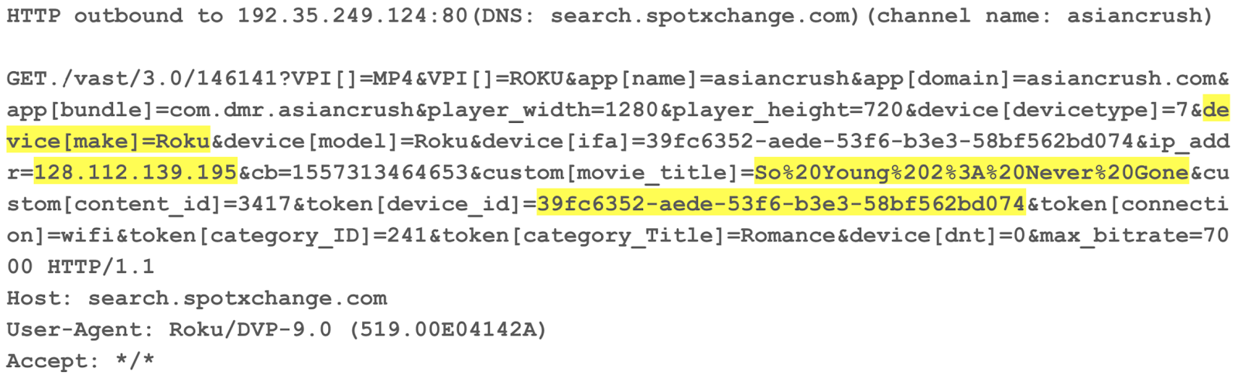
Challenges of analyzing smart TV traffic in lab
tcpdump
How to analyze the traffic of channels at scale?
How to decrypt traffic?

Slide 31

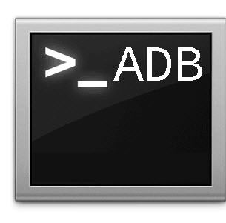



Building a smart TV crawler
Design Goals
Automate TV interactions
Install and launch channels (apps)
Play videos
Detect privacy leaks
Decrypt traffic
Identify sensitive information
Challenges
web & mobile
smart TV
known tools
limited API
allows changing root cert
prohibits changing root cert

Slide 32


Our contributions
Design Goals
Automate TV interactions
Install and launch channels (apps)
Play videos
Detect privacy leaks
Decrypt traffic
Identify sensitive information
Contributions
Built general-purpose smart TV crawler
First large-scale analysis of channels
Sensitive info shared with 3rd party ad/tracking services
Tracking on children without consent

Slide 33

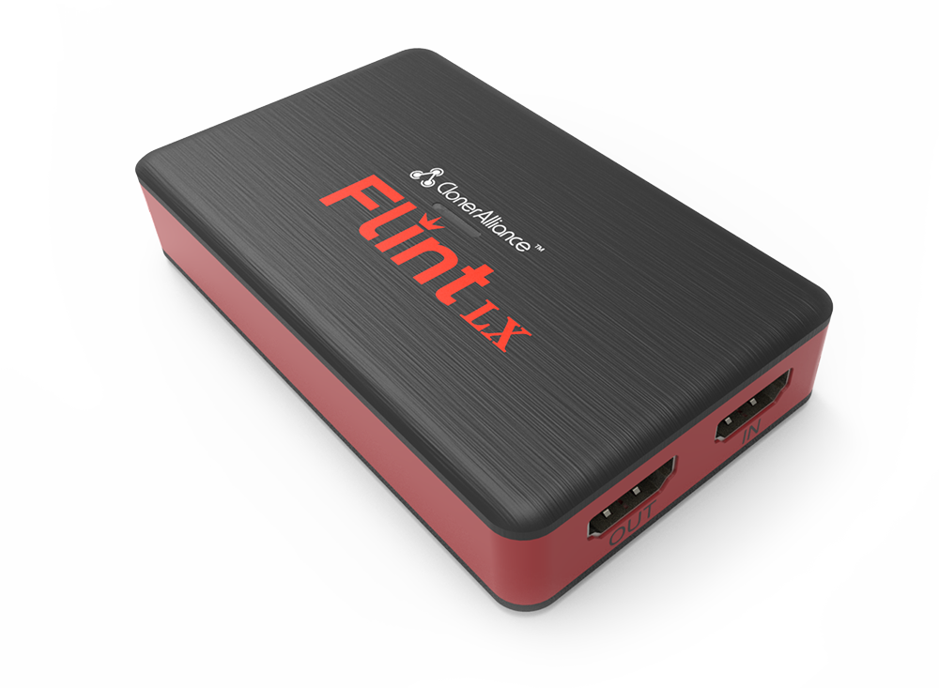
Automating interactions with smart TVs
Design Goals
Automate TV interactions
Install and launch channels (apps)
Play videos
remote control commands
video & audio via USB
network
traffic
HDMI output
HDMI capture card

Slide 34
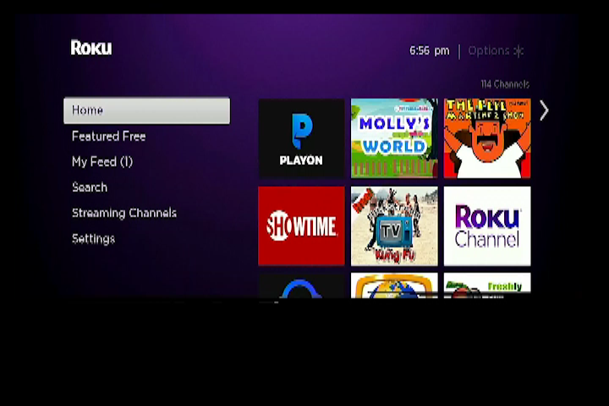
TV crawler interacting with a single channel

Slide 35

TV crawler interacting with channels

Slide 36

Challenges of automatic interactions with channels
navigating to video
detecting video playback

Slide 37
Challenges of automatic interactions with channels
navigating to video
detecting video playback
Sample 100 channels and find popular key sequences:
[OK, OK, OK]
[Down, OK, OK]
[OK, OK, Down, OK, Down, OK]
Crawler brute-forces key sequences
Detect at least 5 seconds of audio playback

Slide 38
Detecting video playback
audio detected (62%)
No audio detected (38%)
manual sample
manual sample
correct (96%)
FP
stuck (75%)
no video

Slide 39
Design goals
Design Goals
Automate TV interactions
Install and launch channels (apps)
Play videos
Detect privacy leaks
Decrypt traffic
Identify sensitive information

Slide 40
Detecting privacy leaks
Design Goals
Automate TV interactions
Install and launch channels (apps)
Play videos
Detect privacy leaks
Decrypt traffic
Identify sensitive information
network
traffic
man-in-the-middle the connection
set up a fake account

Slide 41
Man-in-the-middling traffic
Rooted device
Changed to our certificate
Used Frida to bypass channel-level certificate pinning
Decrypted almost all connections
Unable to root device
Opportunistic man-in-the-middling
validates cert
Server 1
Server 2
Server 3
does not validate cert
Decrypted at least one connection from 5% of the channels

Slide 42
Findings: Ad/tracking companies
 | % channels |  | % channels
Google (Double Click) | 98%
Google Analytics | 36%
Score Card Research | 21%
SpotXchange | 21%
Innovid | 10%

Slide 43
Findings: Ad/tracking companies
 | % channels |  | % channels
Google (Double Click) | 98% | Crashalytics | 35%
Google Analytics | 36% | Google (Double Click) | 31%
Score Card Research | 21% | Google Analytics | 28%
SpotXchange | 21% | Facebook | 20%
Innovid | 10% | App-Measurement.com | 18%

Slide 44
Findings: Sensitive data shared with ad/tracking services
 | % channels |  | % channels
Ad ID | 32%
Channel name | 20%
Serial number | 11%
Zip code | 1%
City or state | 1%

Slide 45
Findings: Sensitive data shared with ad/tracking services
 | % channels |  | % channels
Ad ID | 32% | Android ID | 39%
Channel name | 20% | Ad ID | 22%
Serial number | 11% | Serial number | 10%
Zip code | 1% | MAC address | 5%
City or state | 1% | WiFi SSID | 2%

Slide 46
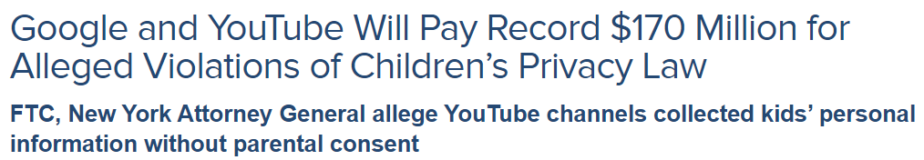
Privacy for children?
September 4, 2019
The “FTC and New York Attorney General allege that YouTube violated the COPPA Rule by collecting personal information—in the form of persistent identifiers that are used to track users across the Internet—from viewers of child-directed channels, without first notifying parents and getting their consent.”

Slide 47
Findings: Privacy leaks in child-directed channels
Number of channels | 1,882 | 1,183
Number of child-directed channels | 470 | 220
Number of child-directed channels that leaked persistent IDs | 34 | 23

Slide 48
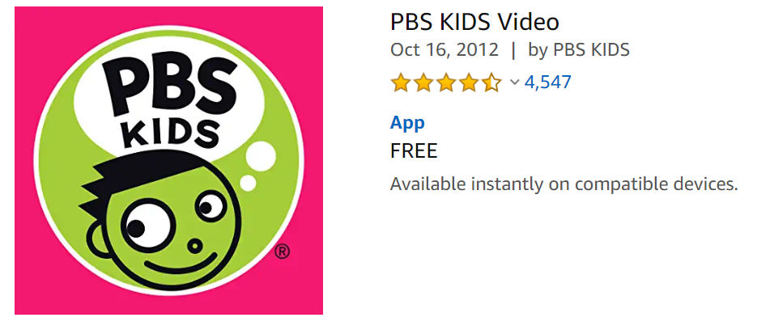

Examples of persistent IDs in child-directed channels
Leaked
Android ID
Leaked
Android ID
Serial Number

Slide 49
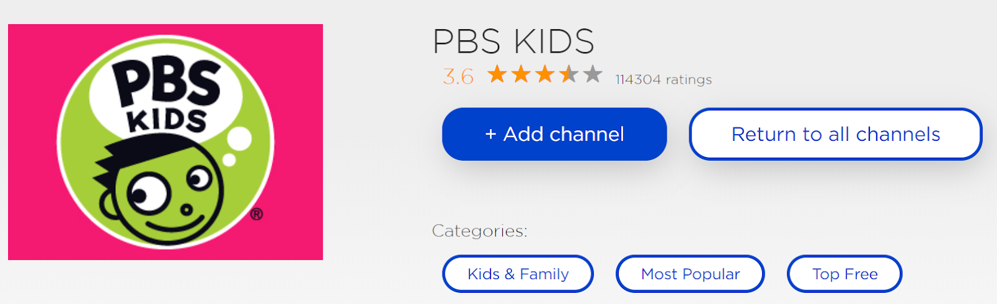
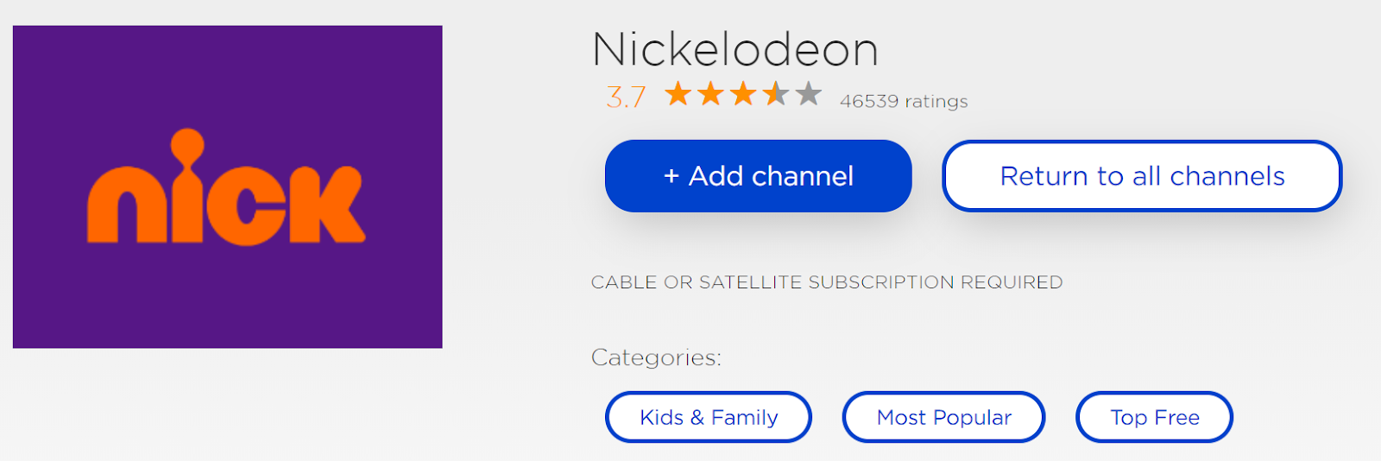
Examples of persistent IDs in child-directed channels
Leaked
Ad ID
Serial Number
Leaked
Ad ID
Serial Number
We are currently working with the FTC for further investigations.

Slide 50


DNS-based block lists may cause some channels to crash
network
traffic

Slide 51
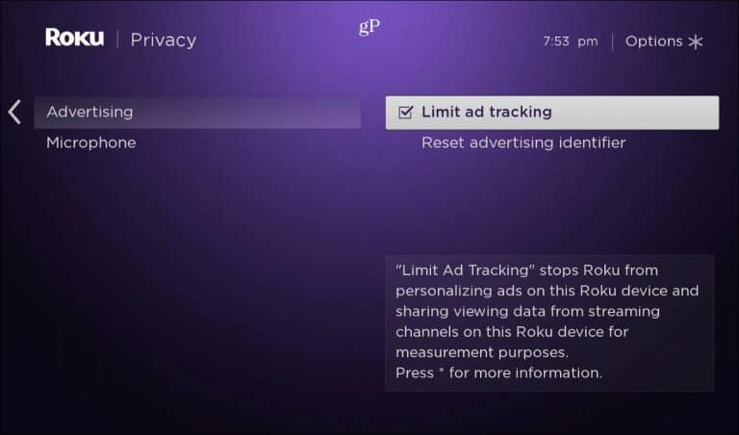
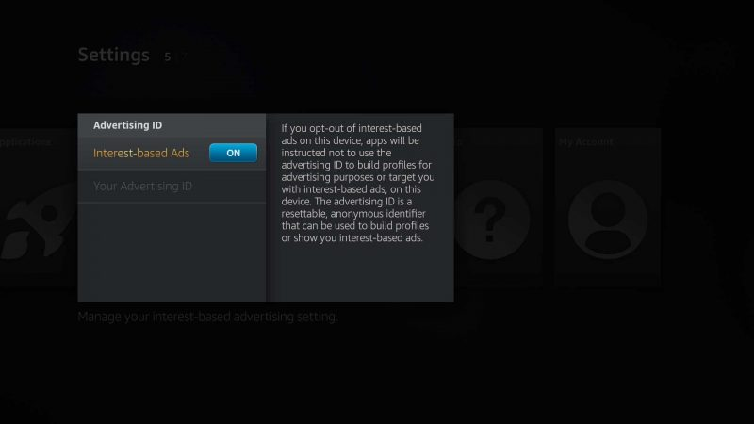
Limited ad tracking (Roku) / No interest-based ads (Amazon)

Slide 52
Finding: Channels still shared persistent IDs under “limited ads”
 | Default % channels | “Limited Ads” % channels |  | Default % channels | No “Interest-based Ads” % channels
Ad ID |  |  | Ad ID
Serial number |  |  | Android ID
 |  |  | Serial number
 |  |  | MAC address

Slide 53
Finding: Channels still shared persistent IDs under “limited ads”
 | Default % channels | “Limited Ads” % channels |  | Default % channels | No “Interest-based Ads” % channels
Ad ID | 30% |  | Ad ID | 35%
Serial number | 14% |  | Android ID | 69%
 |  |  | Serial number | 33%
 |  |  | MAC address | 3%

Slide 54
Finding: Channels still shared persistent IDs under “limited ads”
 | Default % channels | “Limited Ads” % channels |  | Default % channels | No “Interest-based Ads” % channels
Ad ID | 30% | 0% | Ad ID | 35% | 16%
Serial number | 14% | 13% | Android ID | 69% | 65%
 |  |  | Serial number | 33% | 24%
 |  |  | MAC address | 3% | 3%

Slide 55

Summary of tracking on smart TVs
Built Smart TV Crawler, a system to gather empirical evidence of privacy threats from smart TVs
Automatic interactions with channels at scale
Man-in-the-middling (decrypting) channel traffic
First large-scale analysis of smart TV channels
Channels shared sensitive info with 3rd party ad/tracking services
Potential violations of online privacy laws for children
Working with FTC for further investigation

